Slide 1

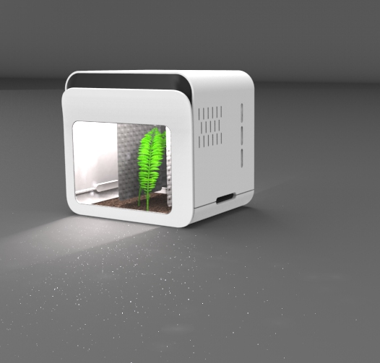
Escargot nursery
Team 1: caracol

Slide 2
Outline
Project management
team
Ethics
problem
Marketingplan
Design
State of the art
Sustainability
Conclusion

Slide 3


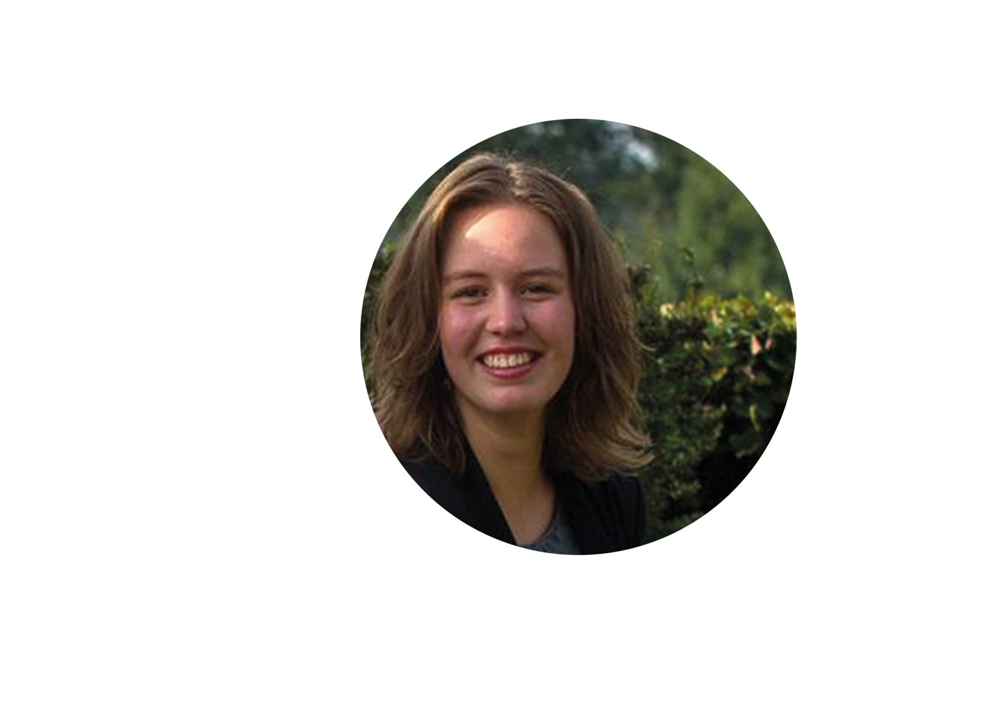


team members
John MaclEan
Ramon Quero
26 years old
Glasgow, Scotland
Mechanical Electronic Systems Engineering
Glasgow Caledonian University
24 years
Madrid, Spain
Civil Engineering
Universidad Politecnica Madrid
Lauri Borghuis
Juliette Portefaix
Benjamin Calon
20 years
Markelo, The Netherlands
Biology & Medical Laboratory Research, Saxion University of Applied Sciences
20 years
Tarbes, France
Engineering
ENIT
23 years
Brugge, Belgium
Product Development,
University of Antwerp

Slide 4
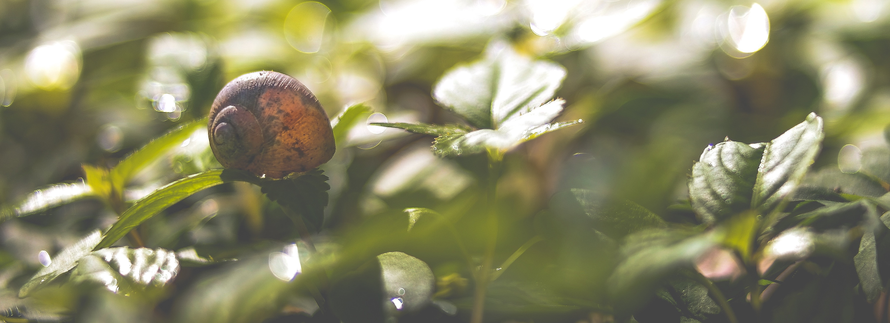
The problem
Genetic modification
Digital revolution
Laws and culture

Slide 5
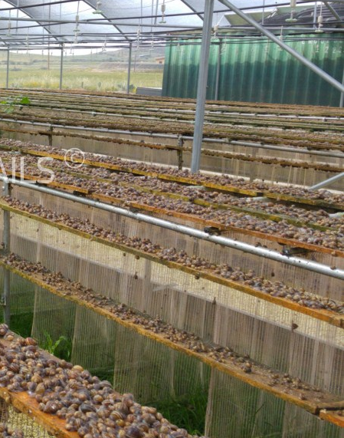
State
of the
art
What: Cornu aspersum
Why:
    France
    6 months
Life conditions
Aquarium concept
Curtain technique

Slide 6
Project management
Useful and important tool
Work Breakdown Structure
Gantt Chart
Risks and costs
Stakeholders Management
Communication

Slide 7
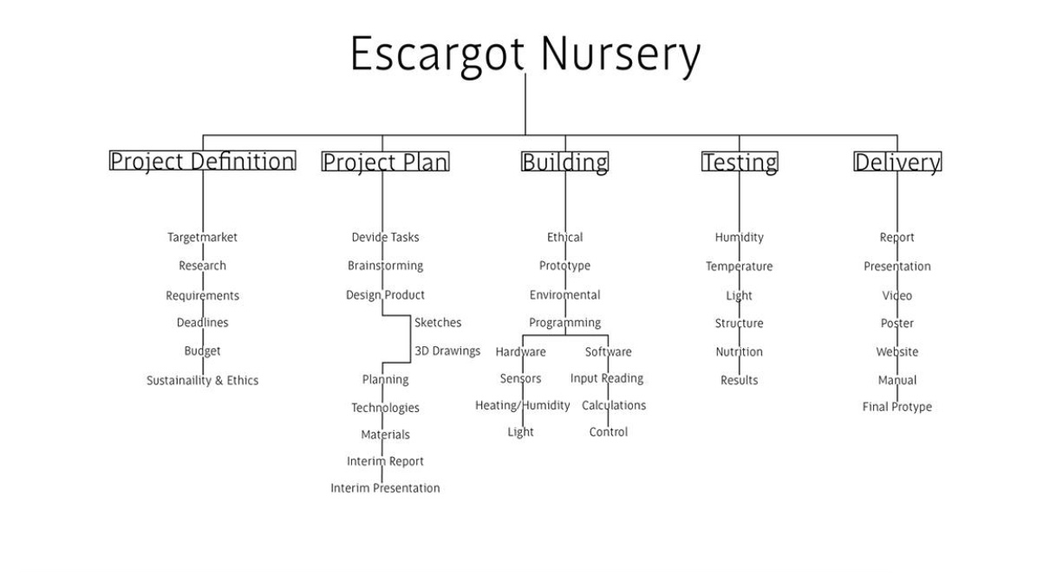
Project management
Useful and important tool
Work Breakdown Structure
Gantt Chart
Risks and costs
Stakeholders Management
Communication

Slide 8
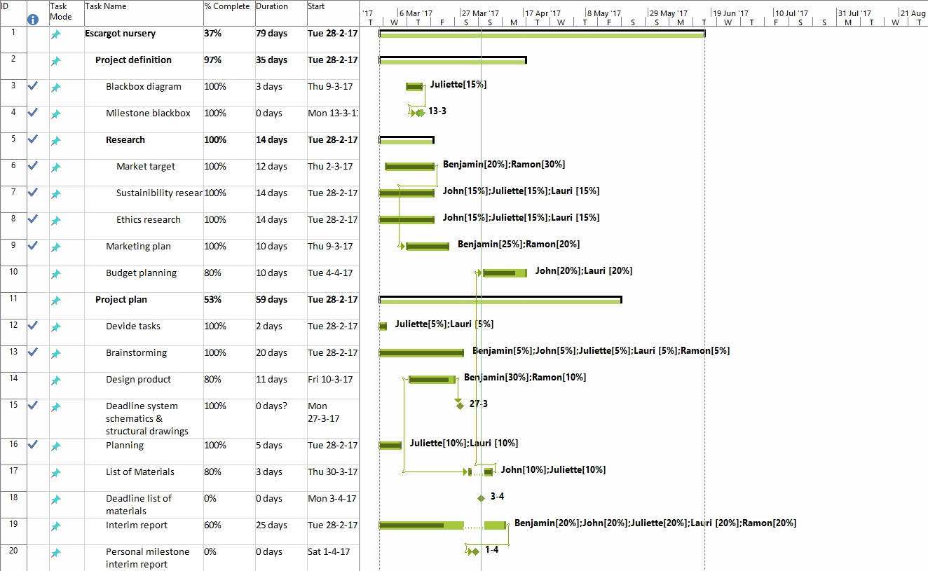
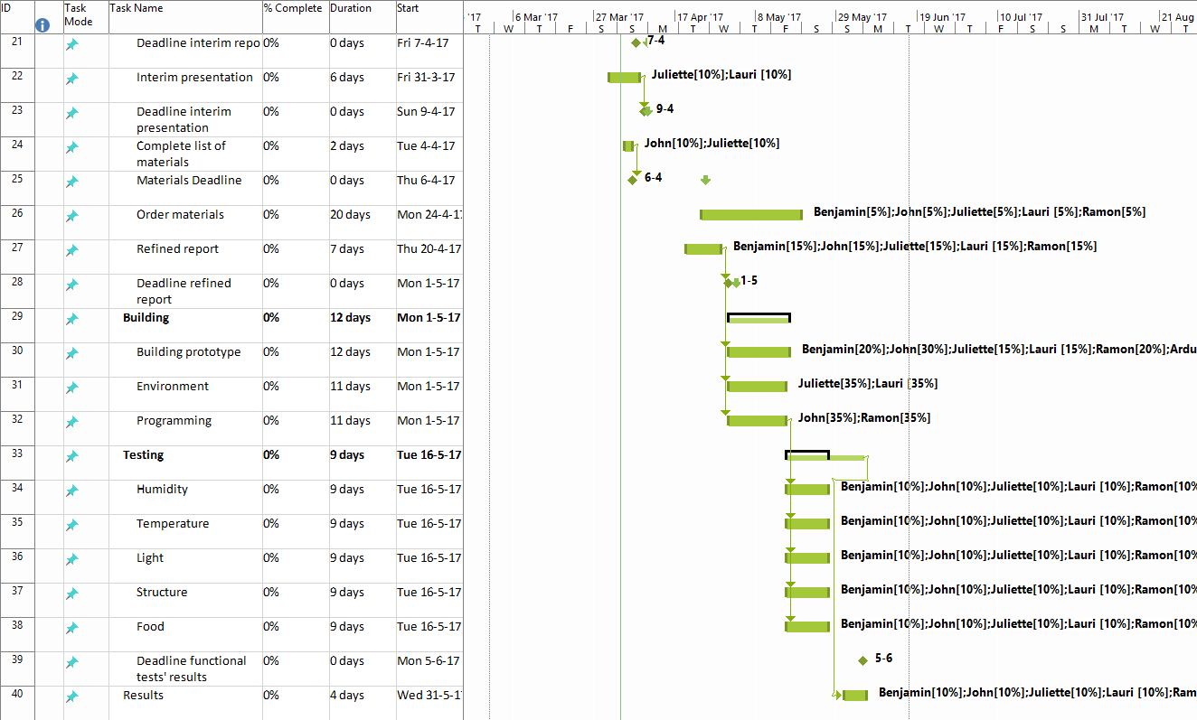
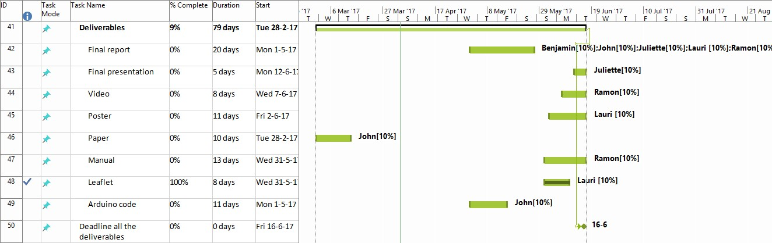
Project management
Useful and important tool
Work Breakdown Structure
Gantt Chart
Risks and costs
Stakeholders Management
Communication

Slide 9
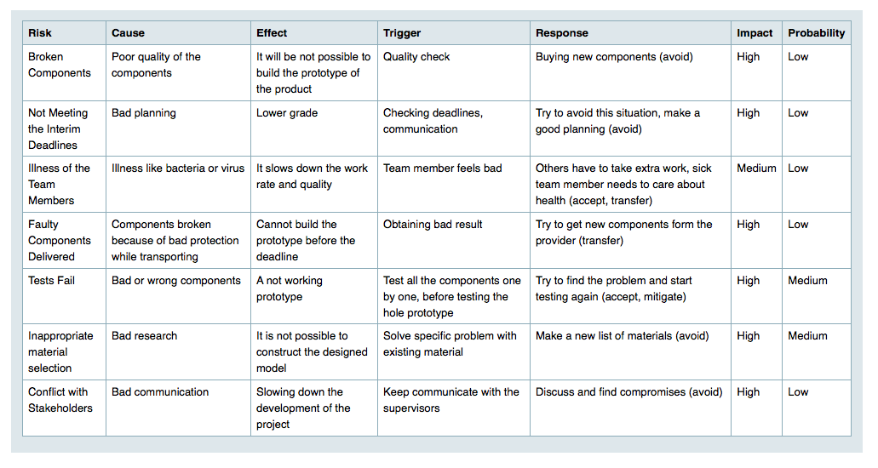
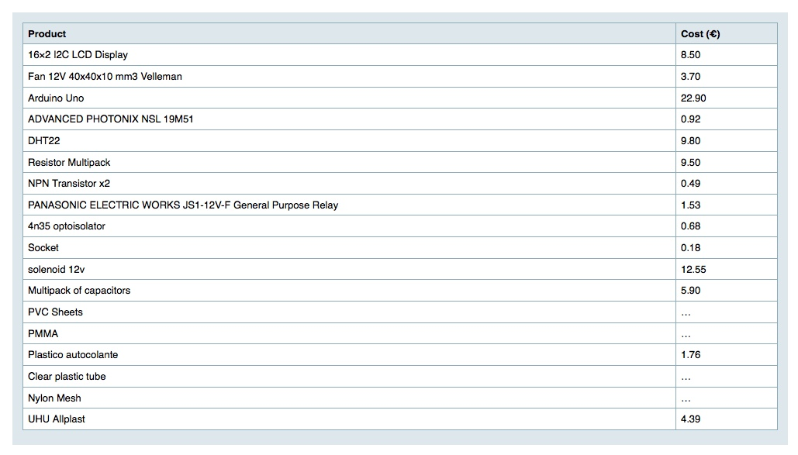
Project management
10
Useful and important tool
Work Breakdown Structure
Gantt Chart
Risks and costs
Stakeholders Management
Communication

Slide 10
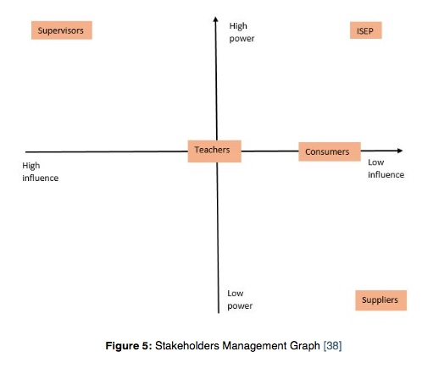
Project management
Useful and important tool
Work Breakdown Structure
Gantt Chart
Risks and costs
Stakeholders Management
Communication

Slide 11
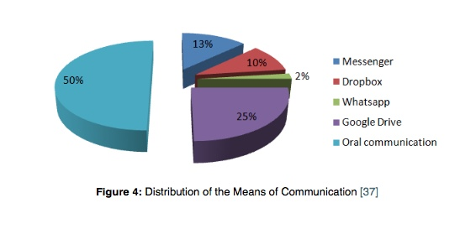
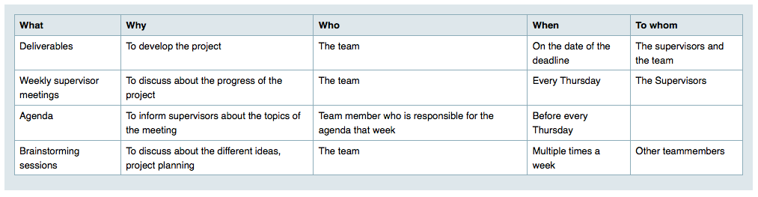
Project management
12
Useful and important tool
Work Breakdown Structure
Gantt Chart
Risks and costs
Stakeholders Management
Communication

Slide 12
Marketing
plan

Slide 13
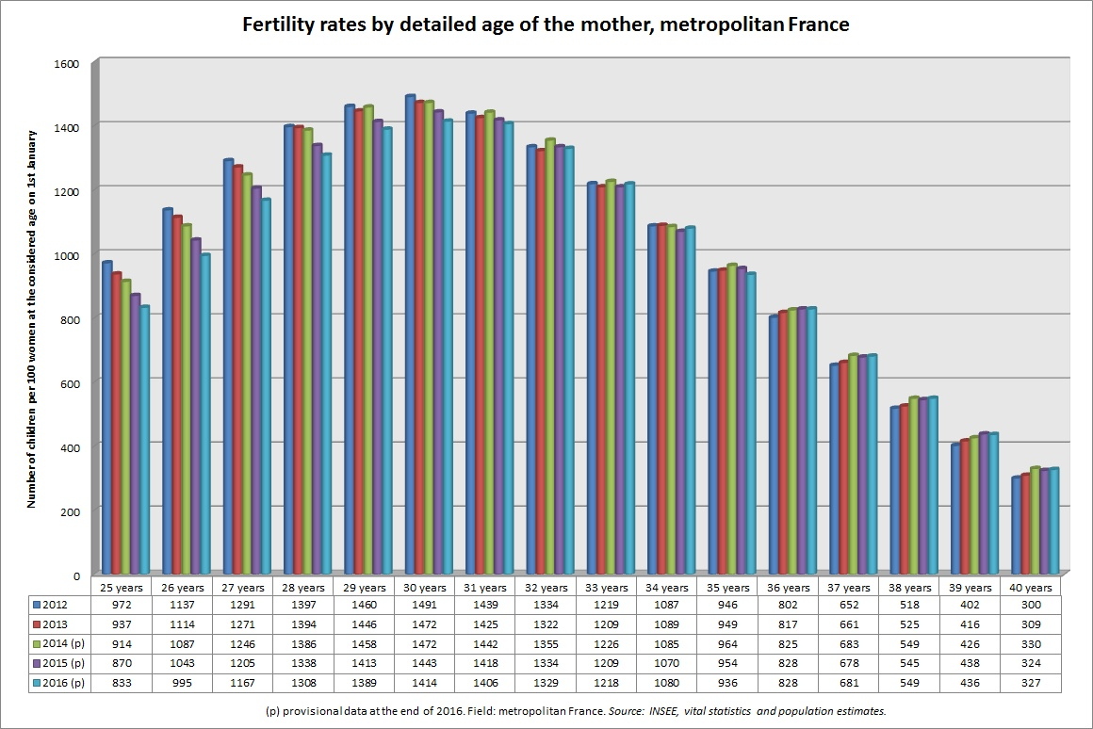
Marketing
plan

Slide 14
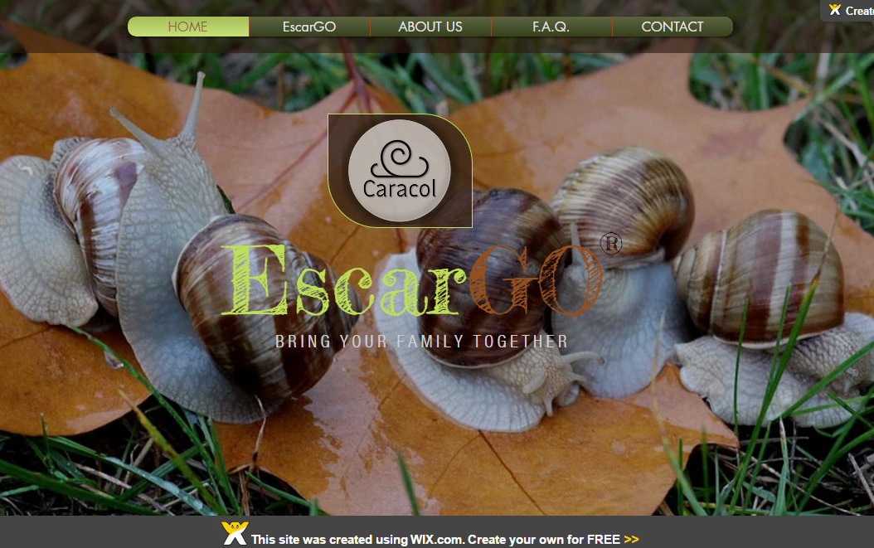
Marketing
plan

Slide 15
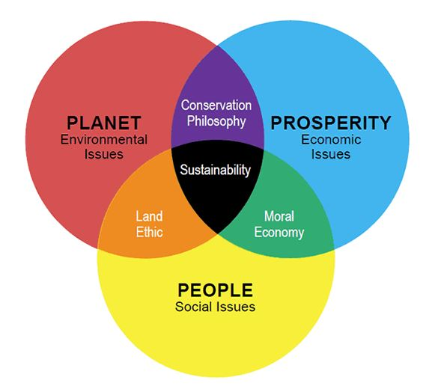
Sustainability
Three main pillars:
  Environment
  Economy
  Social
Aim:
  Preserve environment
  Improve environment
  Develop environment

Slide 16
Sustainability
Development through sustainable production and consumption patterns
Improve equity

Slide 17

Sustainability
How:
  Good insulation
  Use of material: Polypropylene
  Education
  Curtain method
  Local providers and suppliers

Slide 18
Ethical & Deontological Concerns
01. Engineering ethics
03. environmental ethics
02. Sales & marketing ethics
04. Liability

Slide 19
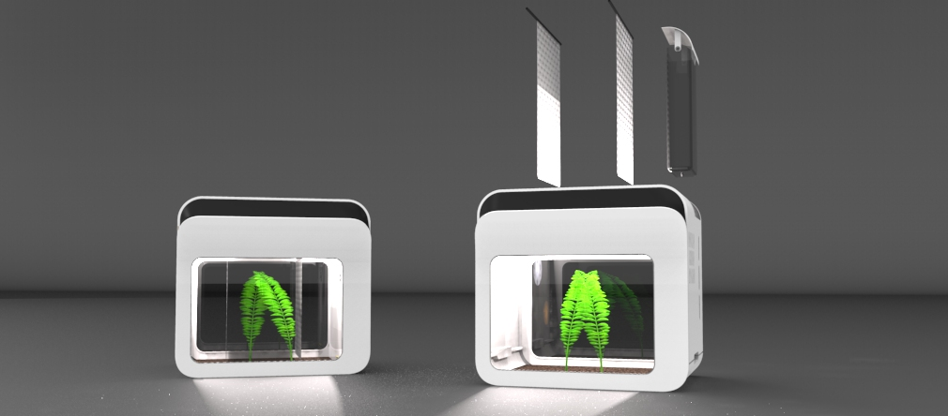
Product development

Slide 20
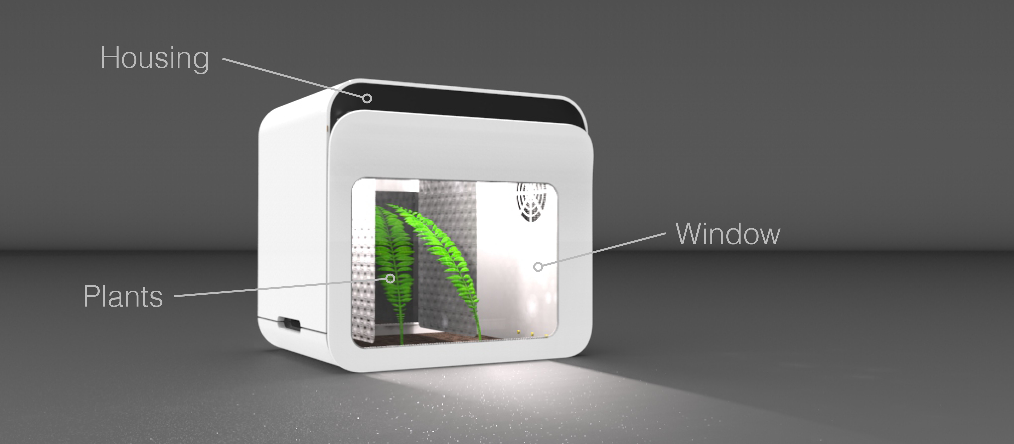
Product development

Slide 21
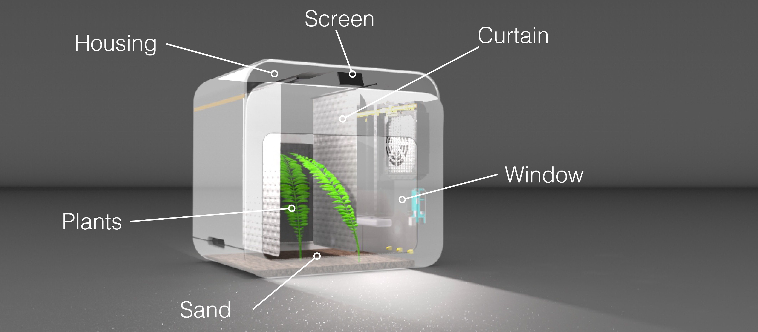
Product development

Slide 22
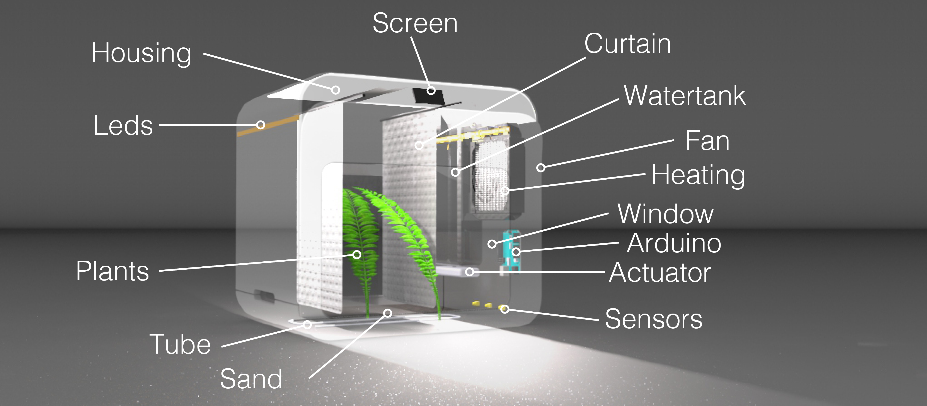
Product development

Slide 23
Product development

Slide 24
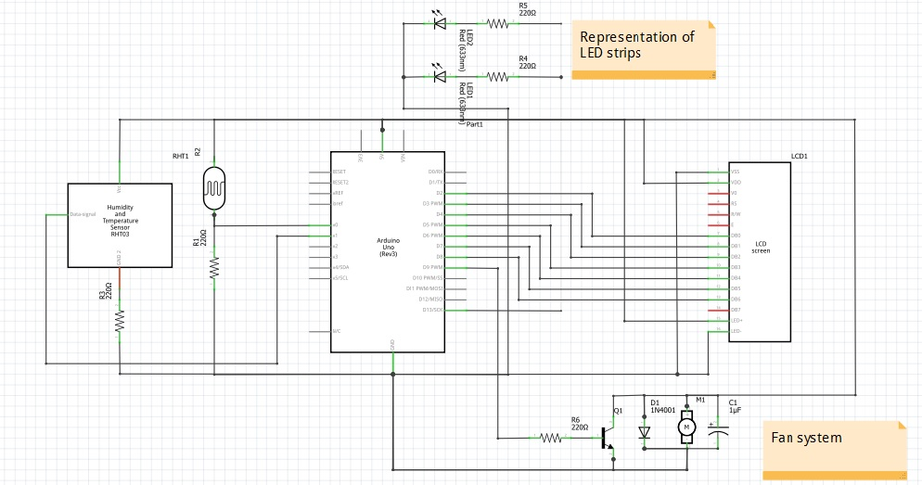
Product development

Slide 25
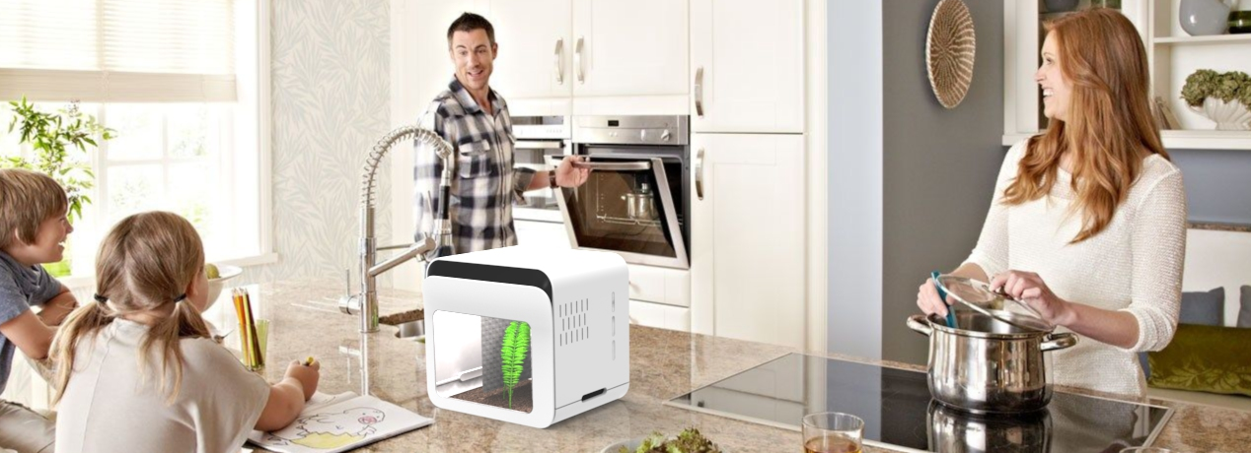
Conclusion
Education
Home
France
Family
Environment
Economy
Social
Ethical

Slide 26
Thank you

Slide 27
pictures:
:http://snailbreeding.net/wp-content/uploads/2016/04/2016-03-23-09.45.12-1024x768.jpg
https://unsplash.com/search/snails?photo=2714ww65eqQ
http://becraftplus.com/wp-content/uploads/2016/10/kitchens-for-families.jpg

